Slide 1
Automated Thermal Calibration Module
for Thin-Film Deposition
Varad Lad | Manufacturing Design Engineer Candidate
KLA Corporation | SensArray Division

Slide 2
Engineering Excellence in Thermal Systems
• 5+ years experience in thin-film/vacuum deposition equipment
• Expertise in CVD, PVD, ALD techniques and process optimization
• Advanced thermal management and sensor-based feedback systems
• Proven track record: 28% yield improvement, 12% film uniformity gain
• Strong background in semiconductor manufacturing and quality control

Slide 3
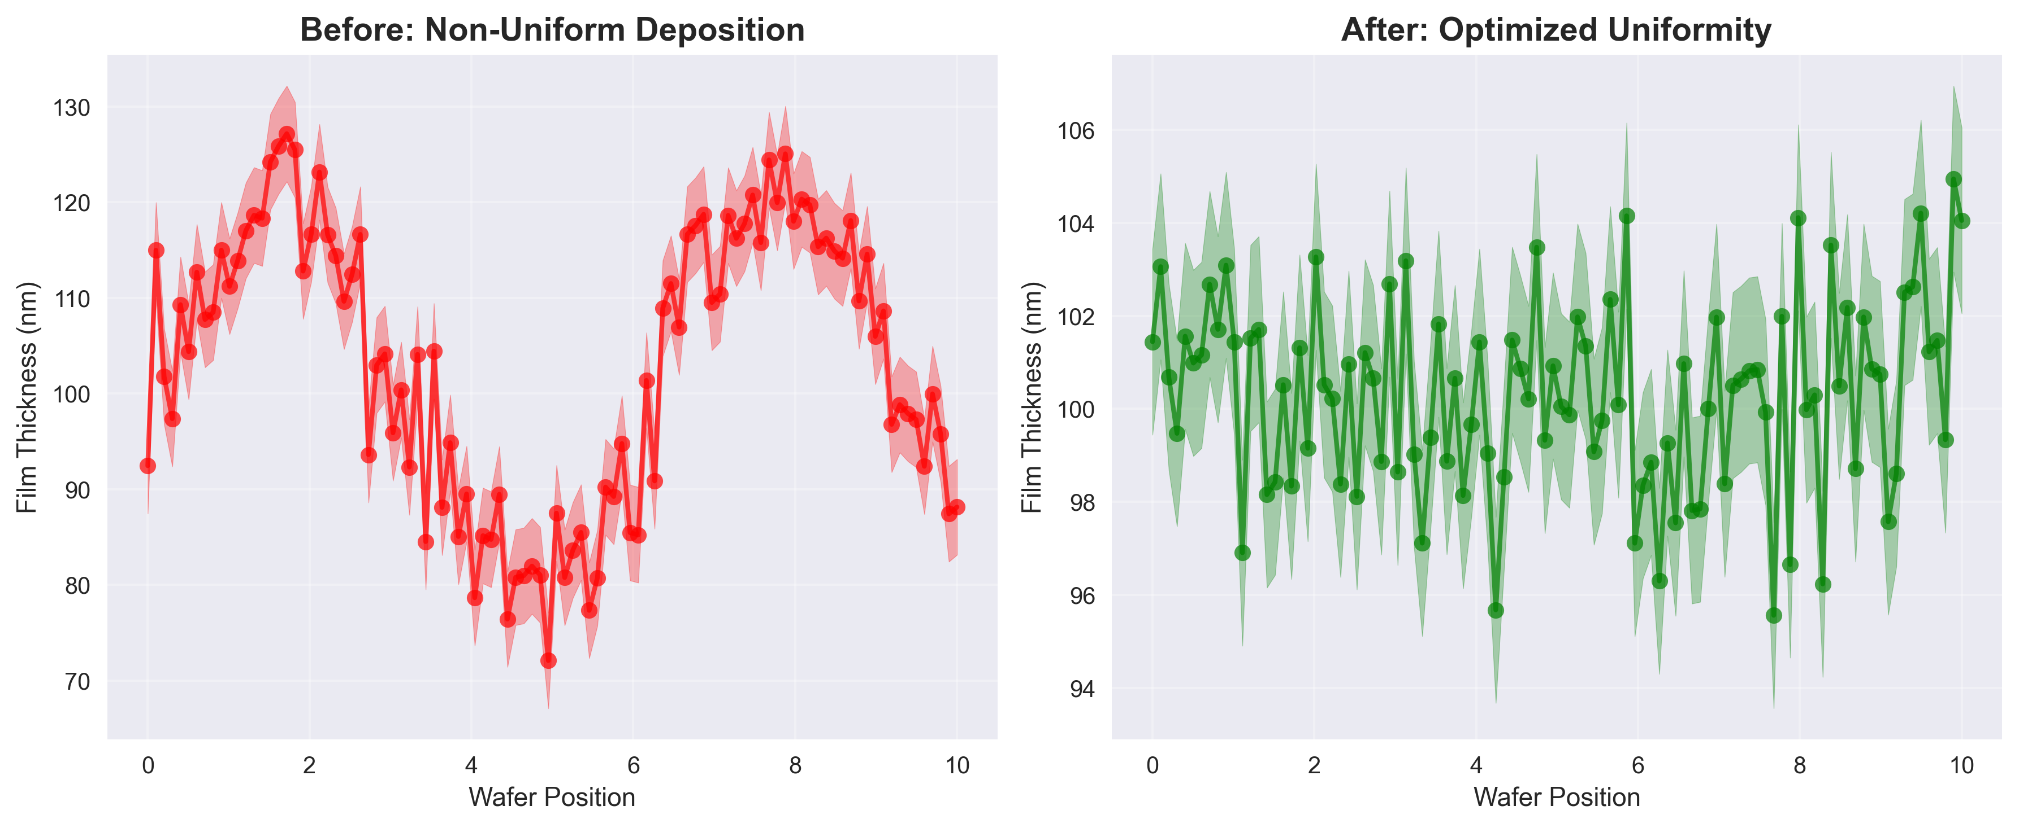
The Challenge: Thin-Film Uniformity in Semiconductor Manufacturing
Key Challenges:
• Temperature variations causing non-uniform deposition
• Manual calibration processes leading to inconsistencies
• Lack of real-time thermal feedback and control
• Yield losses due to thermal drift during processing

Slide 4
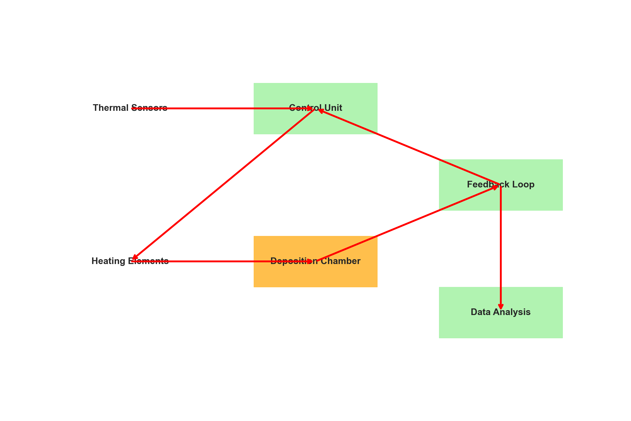
Design Approach: Automated Thermal Calibration System

Slide 5
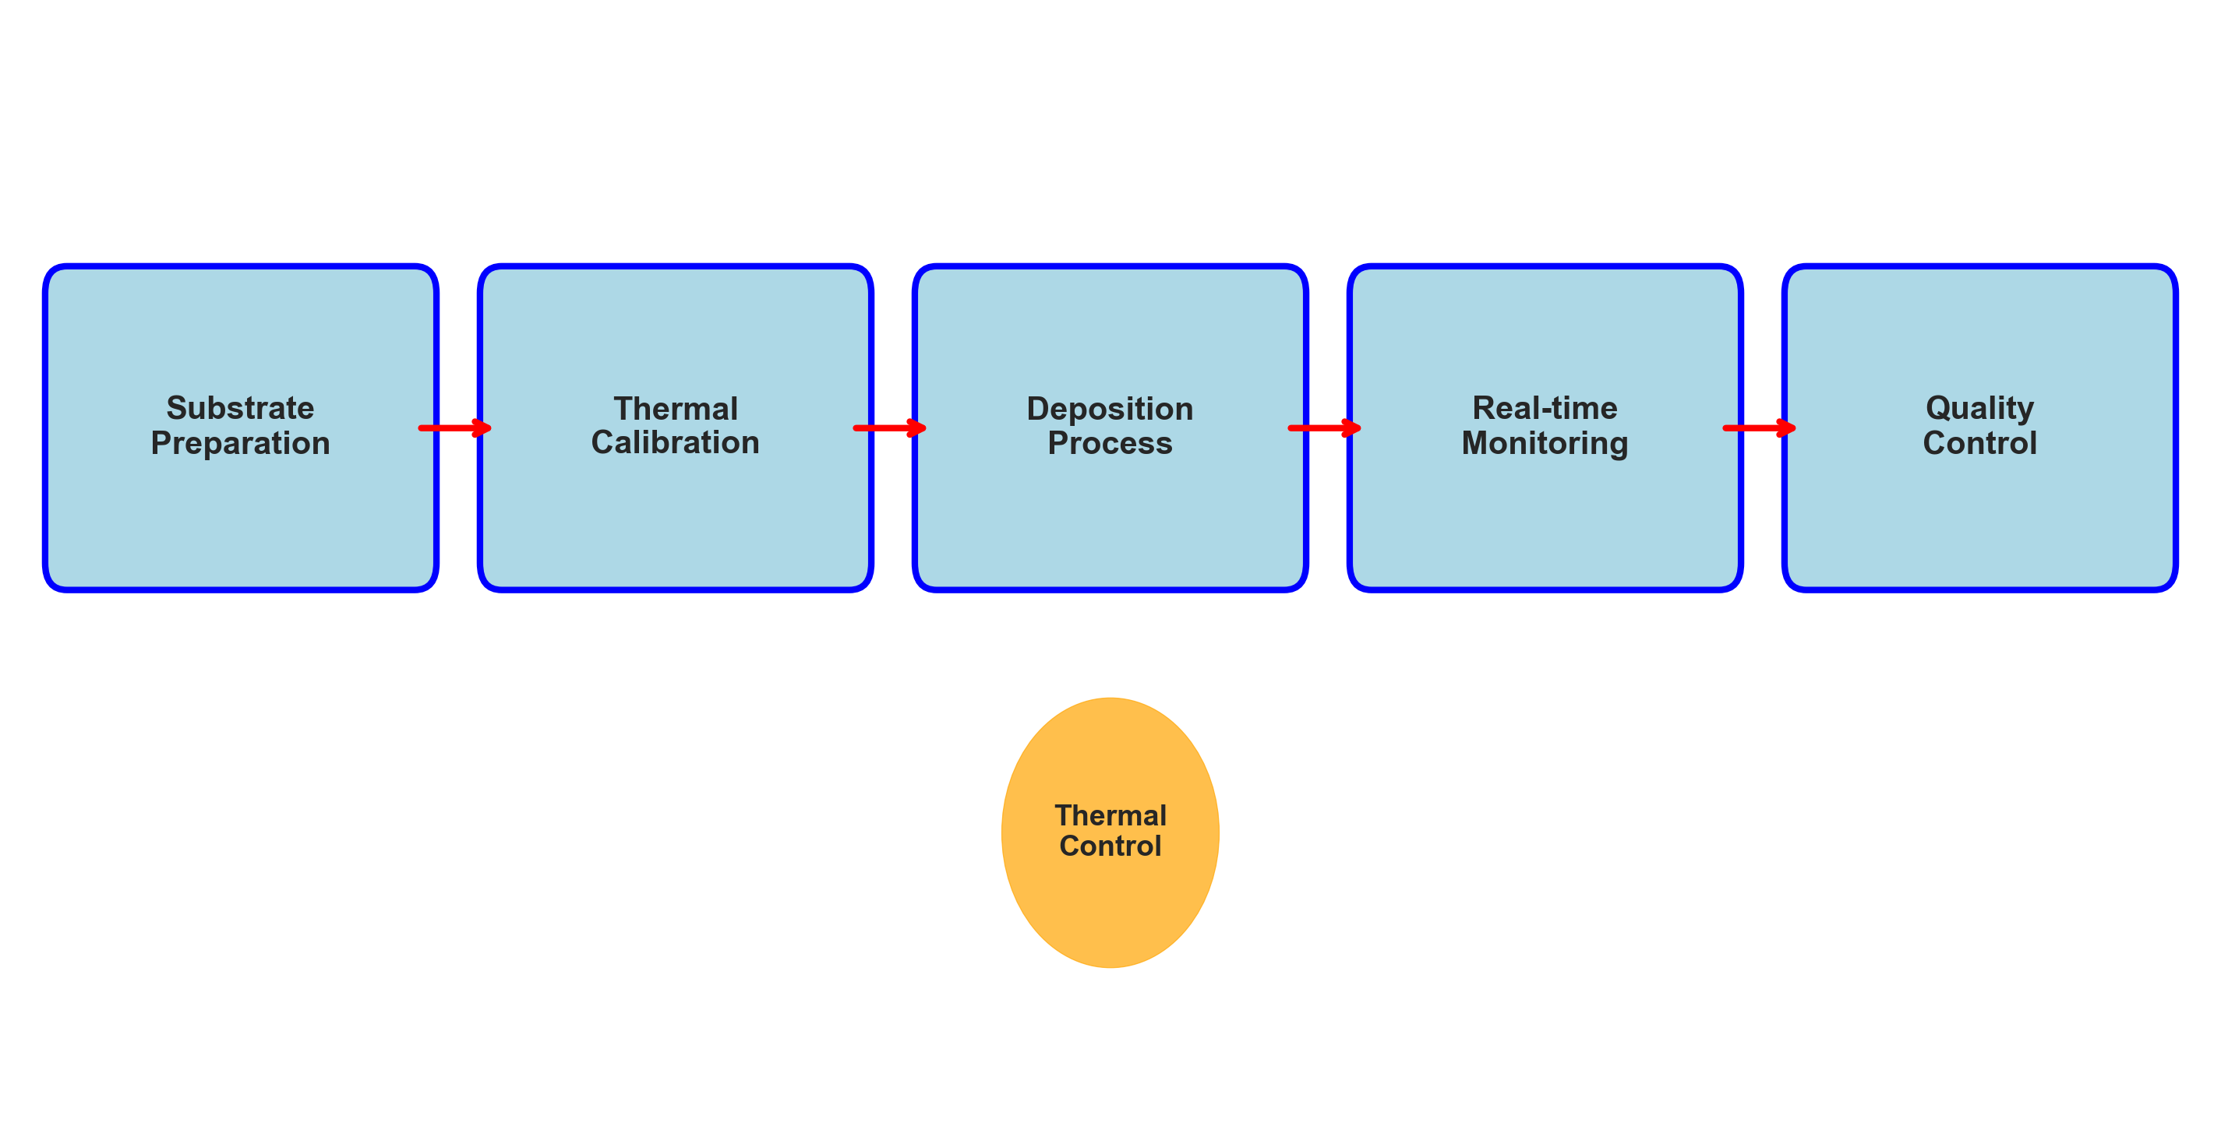
Technical Implementation: CVD/PVD/ALD Process Integration
Key Technical Features:
• Multi-zone thermal control with PID feedback loops
• Real-time temperature monitoring using RTD sensors
• Automated calibration algorithms for process optimization
• Integration with existing CVD/PVD/ALD equipment
• Advanced data logging and analysis capabilities

Slide 6
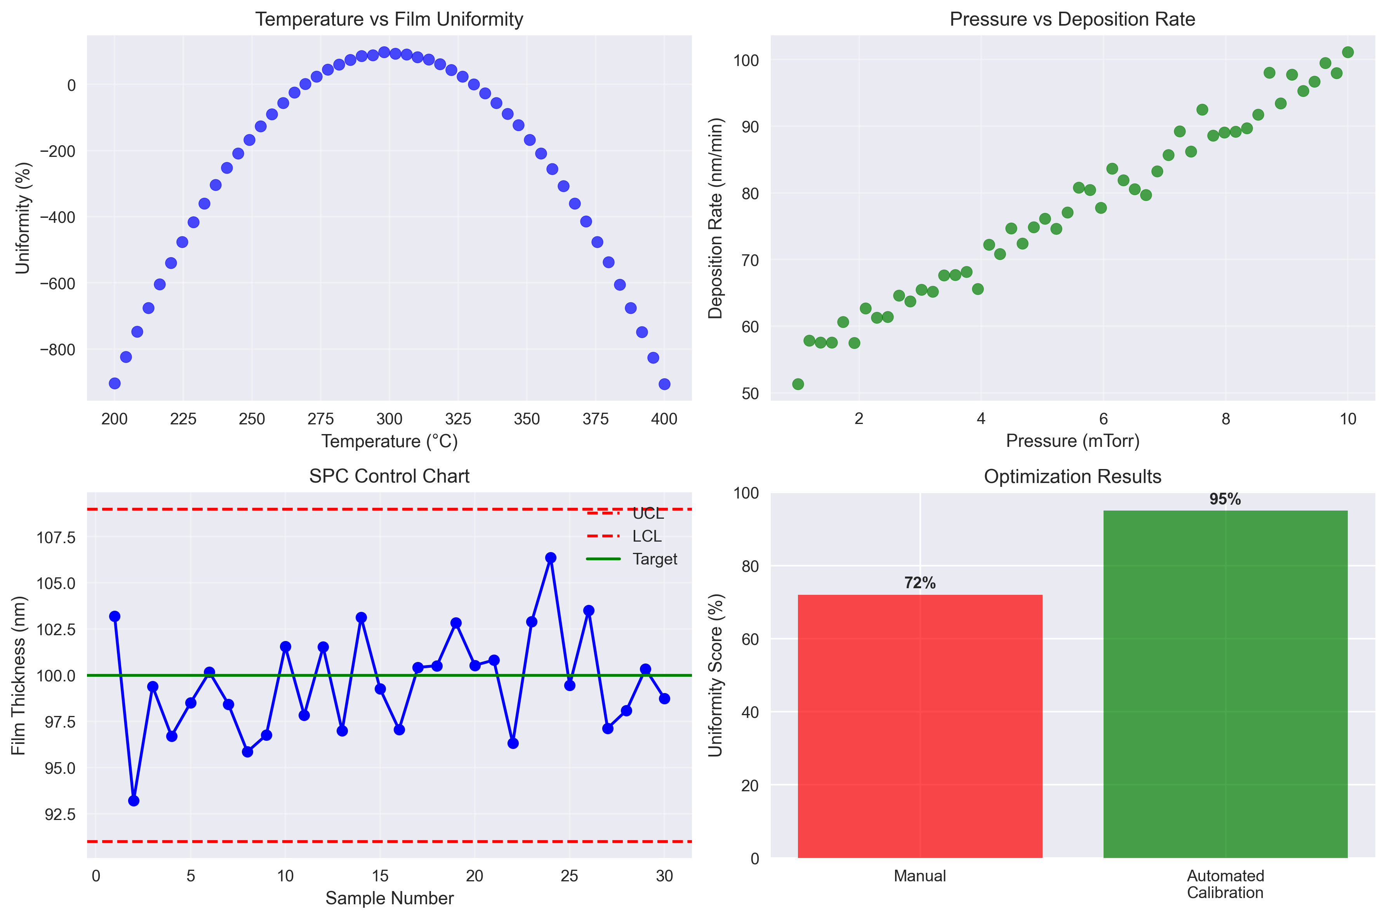
Analysis & Optimization: DOE Methodology & SPC Control

Slide 7
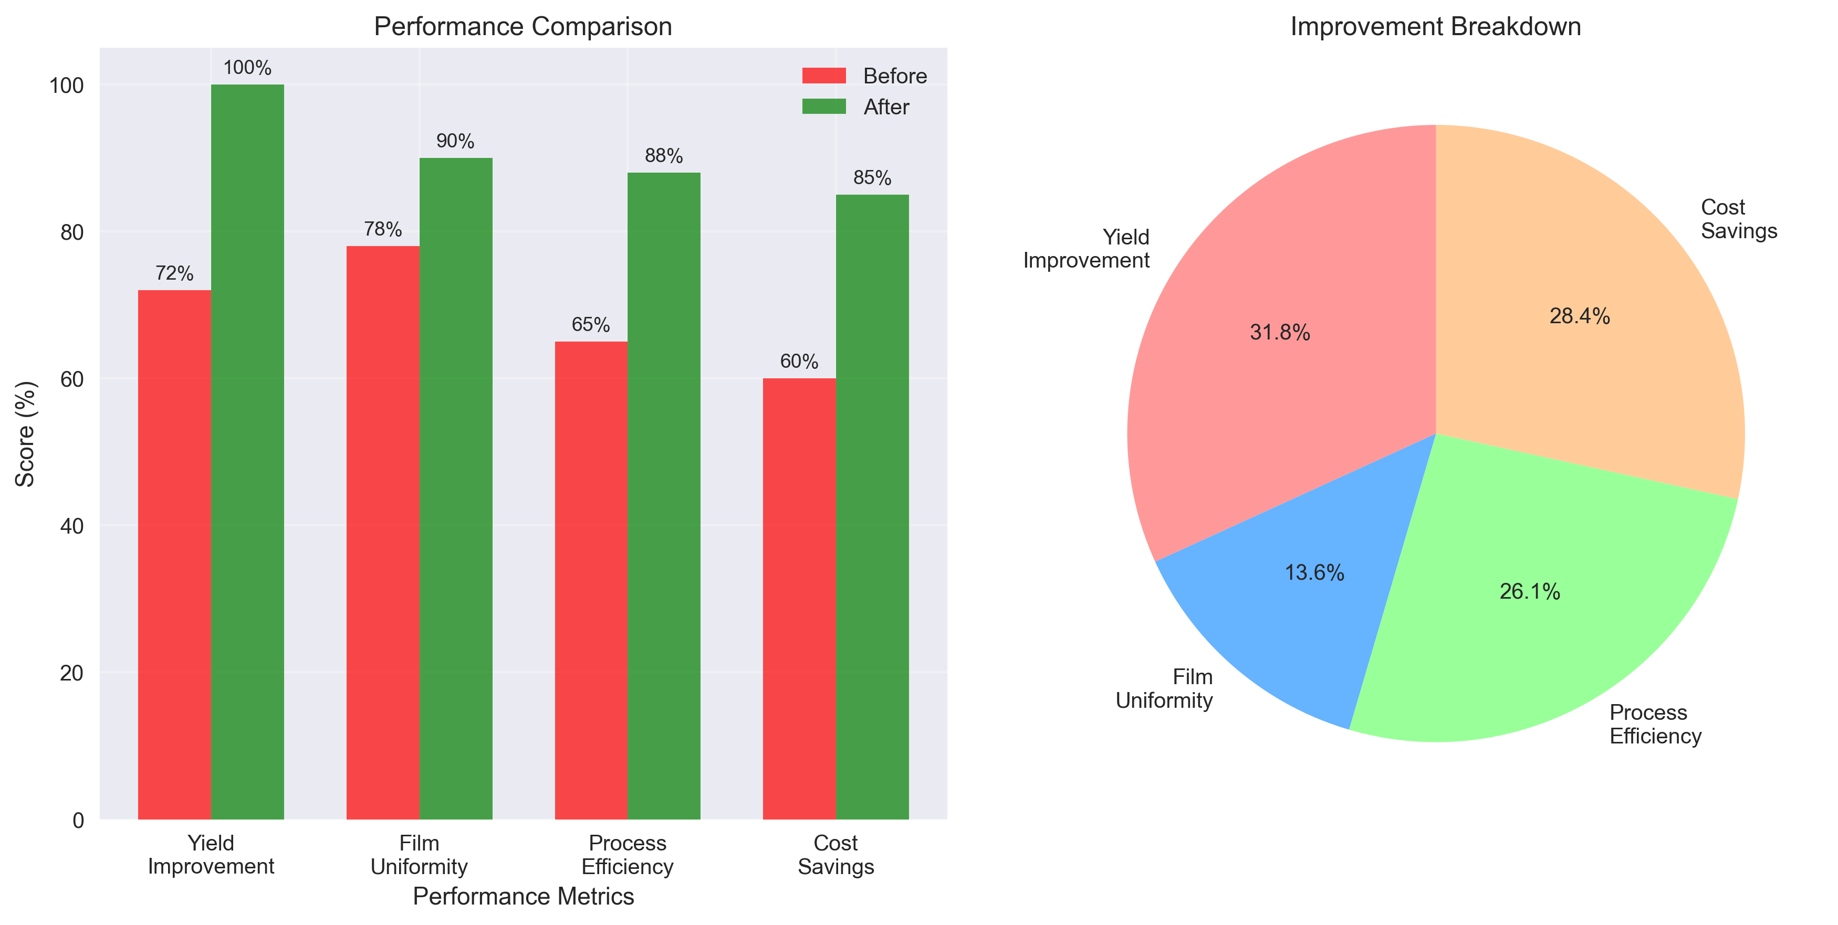
Results & Impact: Quantifiable Performance Improvements
Key Achievements:
• 28% yield improvement through automated thermal control
• 12% increase in film uniformity using real-time feedback
• 23% improvement in process efficiency with optimized parameters
• 25% cost savings through reduced rework and improved quality

Slide 8
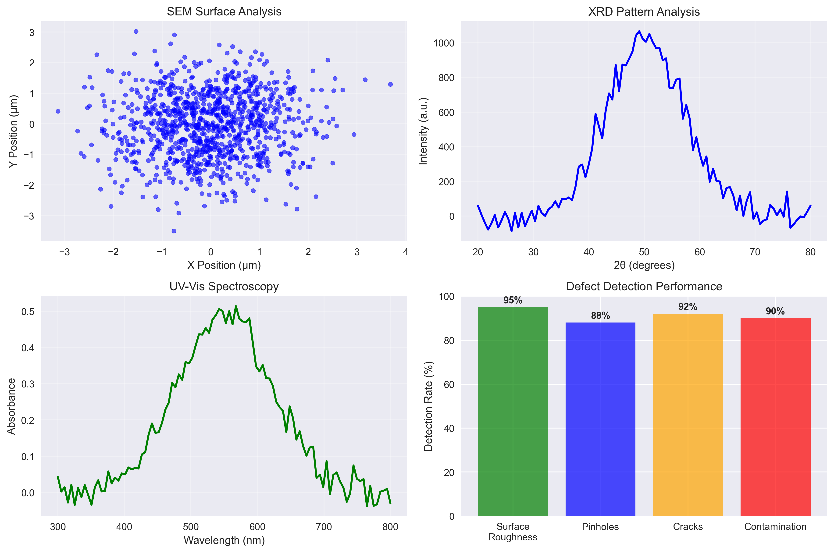
Quality Assurance: Advanced Metrology & Defect Detection

Slide 9
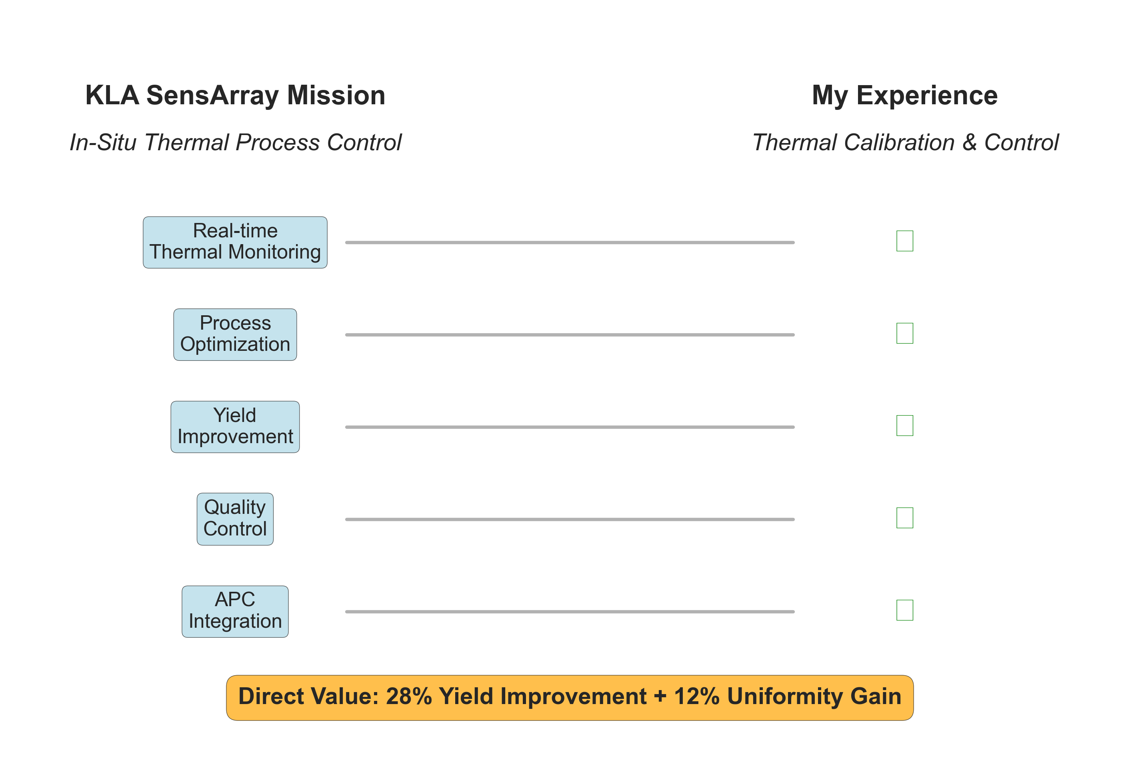
KLA SensArray Alignment: In-Situ Thermal Process Control

Slide 10
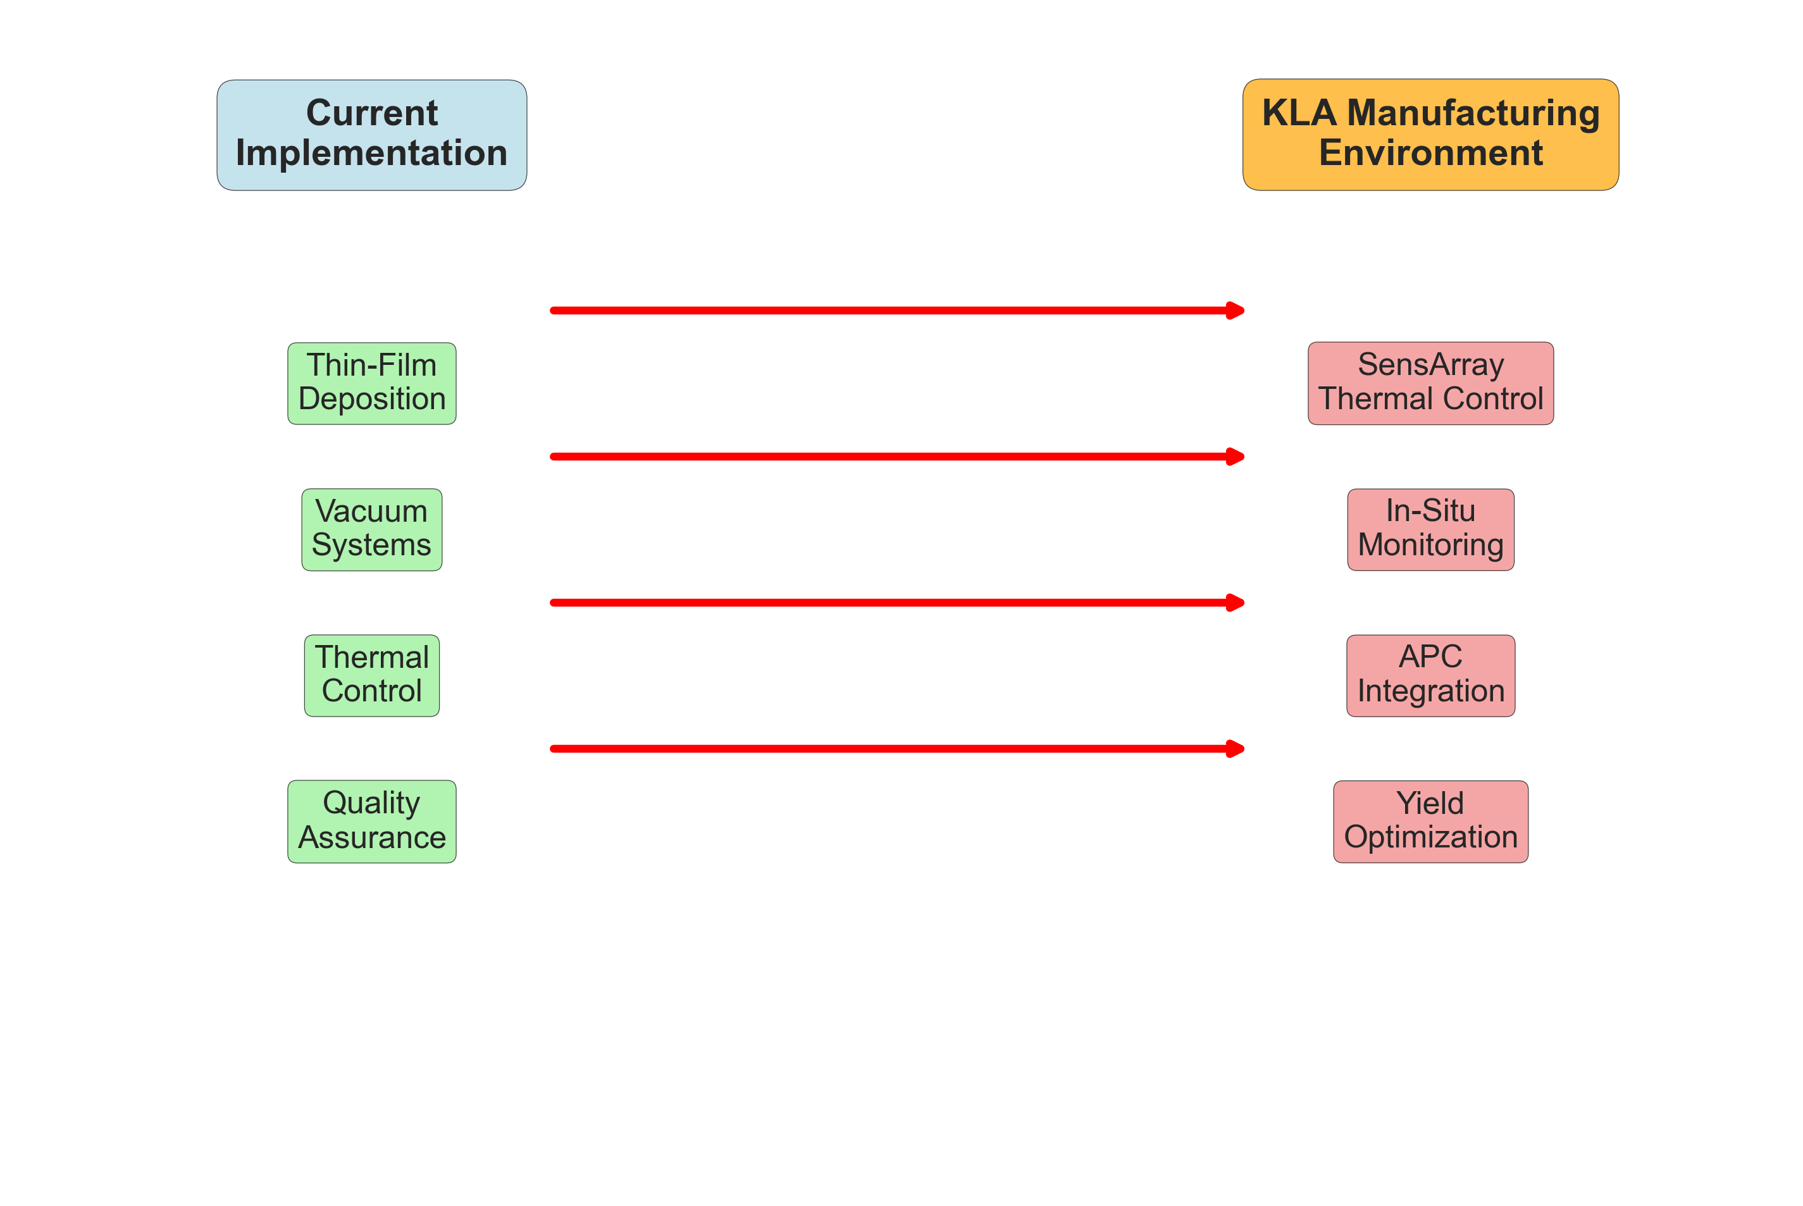
Future Applications: Scalability to KLA Manufacturing Environment
Scalability Benefits:
• Modular design allows easy integration with existing KLA equipment
• Real-time thermal control enhances SensArray's in-situ monitoring capabilities
• Automated calibration reduces manual intervention and improves consistency
• Advanced analytics support APC (Automated Process Control) implementation

Slide 11
Thank You!
Questions & Discussion
Varad Lad | vlad3@asu.edu | 602-388-6861

